Slide 1

ASSETX
Business Model

Slide 2
Project Team
Meet the dedicated individuals driving AssetX forward.
Mohamed Ashraf
Mohamed Mostafa
Ezz El Din Mohamed
Mohamed Yasser
Youssef Moataz

Slide 3


The Problem
A Fragmented B2B Asset Market
In Egypt, businesses with surplus, used, obsolete, or no-longer-needed assets often struggle to sell them in an organized and efficient way.
Selling these assets often depends on personal networks, brokers, traders, or disconnected marketplaces — making it difficult to reach the right buyers and recover true asset value.
At the same time, companies looking to acquire business assets at lower costs struggle to find suitable products, compare options, and identify reliable corporate sellers.
This creates a fragmented B2B asset market with limited connection between corporate supply and demand.

Slide 4
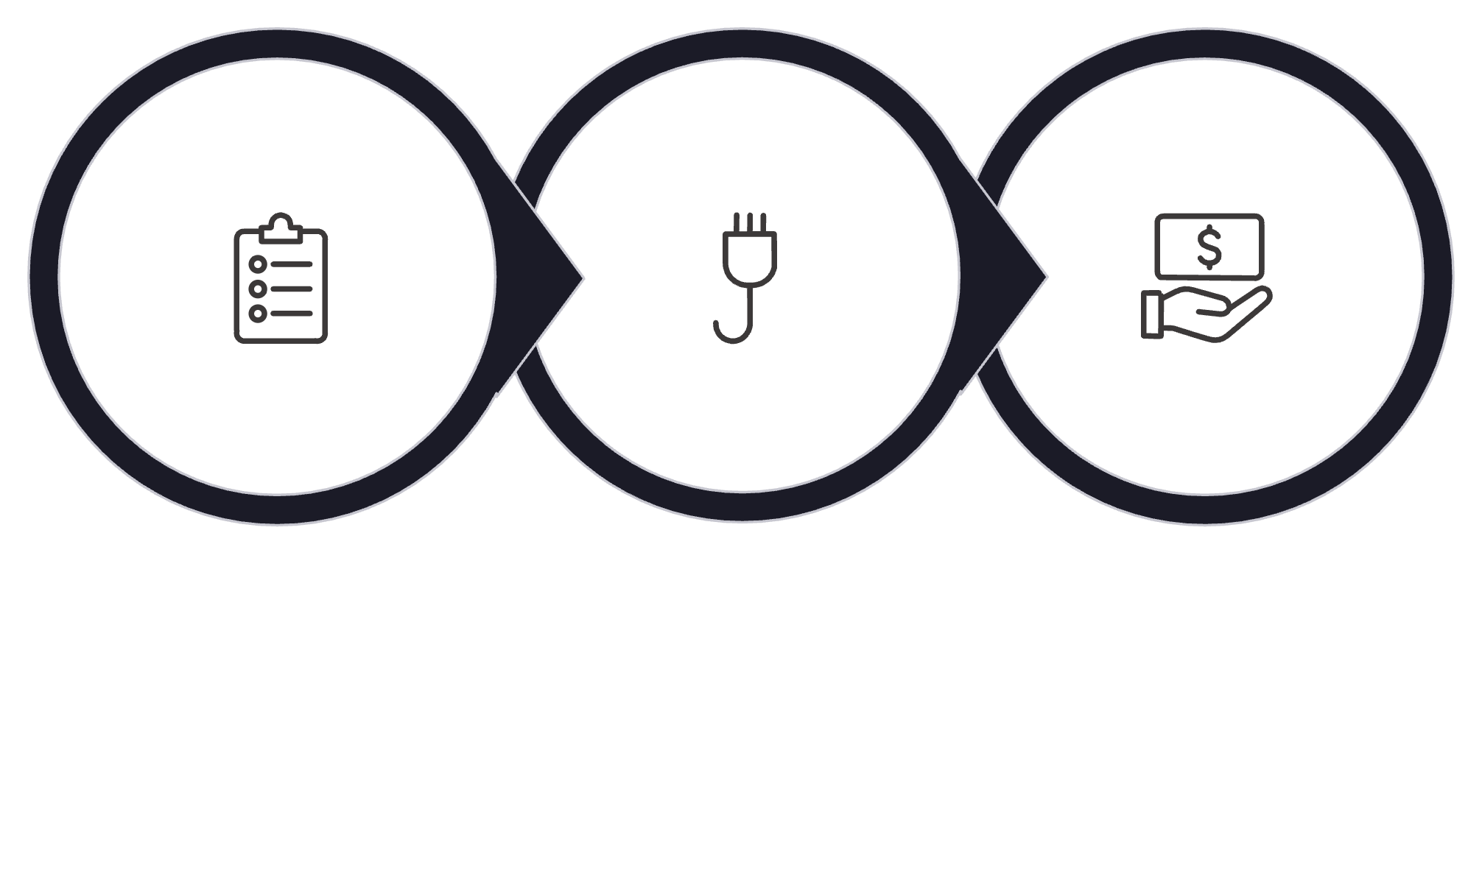
The Solution
A centralized B2B Asset Marketplace that connects companies looking to sell their surplus or used assets with companies looking to acquire them.
List Assets
Connect
Transact
The platform makes B2B asset transactions more organized, accessible, and efficient for all parties involved.

Slide 5

Our Value Proposition
AssetX connects corporate supply with corporate demand in one organized B2B marketplace.
FOR SELLERS
FOR BUYERS
Reach potential corporate buyers
Sell individual assets or batches
Reduce reliance on brokers and personal networks
Choose between Fixed Price and Auctions
Find business assets in one place
Search and filter based on their needs
Access verified corporate sellers
Purchase through Fixed Price
Participate in Auctions
Create RFQs to request specific assets from sellers
CORE VALUE PROPOSITION: We connect corporate supply with corporate demand in one organized B2B marketplace.

Slide 6



Target Users
Understanding the user landscape of AssetX's B2B asset marketplace.
Seller Side — Supply
Buyer Side — Demand
Admin — Platform Operations
Company Types: Tech & Software Companies, Call Centers, Growing Enterprises, Companies undergoing Hardware Upgrades
Decision Makers: IT Managers / CTOs, Procurement Managers, Operations Managers, Founders
These companies have surplus or replaced equipment they want to sell and recover value from.
Company Types: Startups, Small & Medium Businesses, Co-working Spaces, Training Academies
Decision Makers: Operations Managers, Procurement Managers
They are looking for reliable business equipment at lower costs than buying new.
Responsibilities: User and company management, listing moderation, monitoring Auctions and RFQs, supporting dispute handling.

Slide 7



Convincing the First Users
For the first 10 verified companies, AssetX offers an unbeatable entry offer:
0% Transaction Commission
No fees during the initial stage — free listings to get your first assets on the platform.
Direct RFQ Access
Immediate access to relevant RFQs from verified corporate buyers.
Fast Bulk Listing
Simple and fast bulk listing tools to get your inventory live quickly.
Verified Corporate Users
All users are verified companies — increasing trust on both sides of the marketplace.

Slide 8
Competitor Analysis
🇪🇬 Egyptian Competitors
🌍 Global Competitors
ACE Group
eMazad
Ritchie Bros.
IronPlanet
Industrial Asset Marketplace + Asset Valuation
Online Auctions + Corporate Asset Sales
Heavy Equipment + Auctions
Used Equipment + Inspection & Condition Reports
OLX / dubizzle Egypt
OpenSooq Egypt
MachineryTrader
Machinio
General Marketplace + Business & Industrial Listings
Equipment Marketplace + Want-to-Buy
Industrial Equipment Search + Buyer–Seller Connection
General Marketplace + Equipment Listings

Slide 9
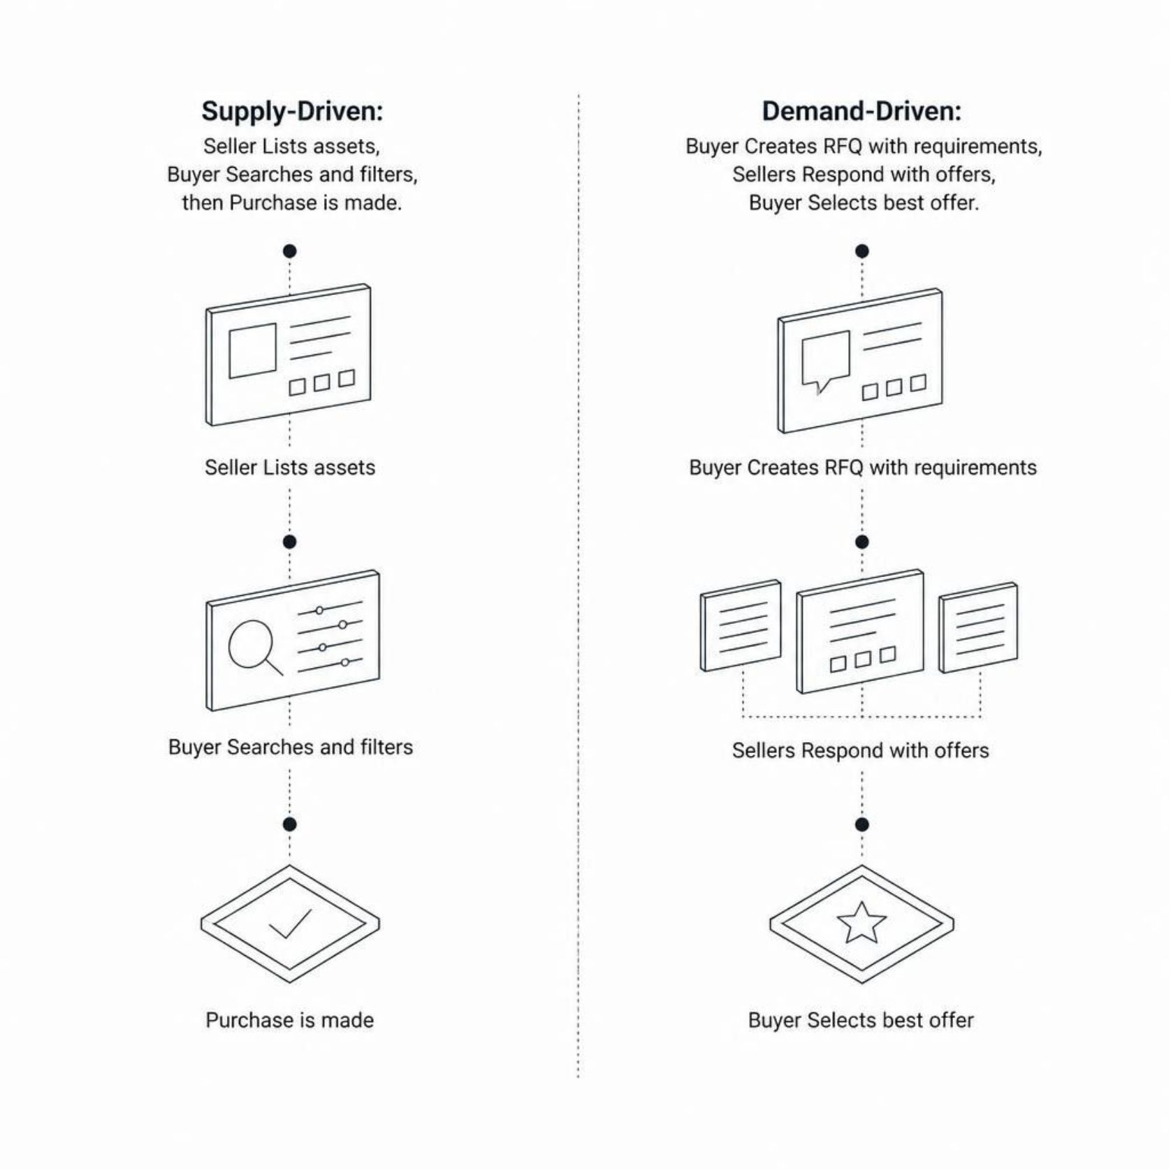
Competitive Gap & Differentiation
Where Competitors Fall Short
Most competitors focus primarily on one side of the market or one transaction model:
Auctions → eMazad, Ritchie Bros.
Equipment → IronPlanet, MachineryTrader, Machinio
General Listings → OLX / OpenSooq
Our Opportunity
A B2B Corporate Asset Marketplace combining Fixed Price + Auctions + RFQs in one platform.
"We don't just help companies sell what they have
we also help buyers request what they need."

Slide 10





User Acquisition Strategy
Our main strategy is Direct B2B Outreach, targeting IT Managers, CTOs, Procurement Managers, Operations Managers, and Startup Founders.
Direct Outreach
LinkedIn, Email, Phone Calls, WhatsApp
First Users
10 verified companies onboarded with 0% commission
Initial Transactions
Partnerships with IT Providers, Hardware Distributors & Startup Communities
Referrals & Growth
Word-of-mouth and targeted Digital Marketing

Slide 11
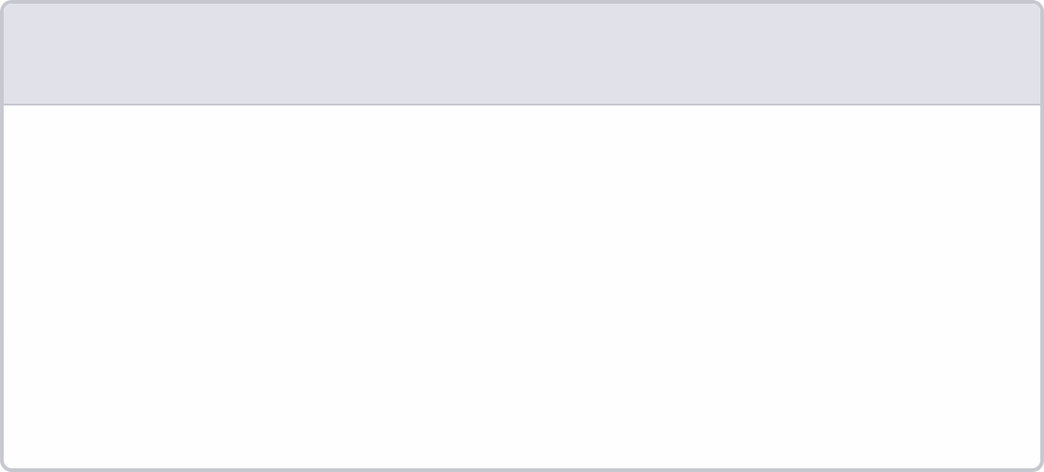

MVP — Minimum Viable Product
TARGET CATEGORY: Electronics
1
2
3
SELLER
BUYER
ADMIN
Registration & profile
Asset/batch listings
Fixed price & basic auctions
Listing management
Registration
Search, filters & asset details
Fixed-price purchase
Auction bidding
RFQs
User & company management
Listing moderation
Basic auction & RFQ monitoring
Auction Rules
Refundable deposits reduce fake participation.
Seller deposit prevents cancellation after auction start.
Buyer deposit prevents fake bids or non-completion.
Auctions cover full asset or full batch only.
Out of Scope
Mobile app
AI pricing
Logistics
Advanced analytics
Advanced auction features
Live payment processing / real-money escrow
Payments will be simulated or run in sandbox for MVP validation.
KEY DIFFERENTIATORS
Auctions + RFQs → supply-driven & demand-driven transactions

Slide 12
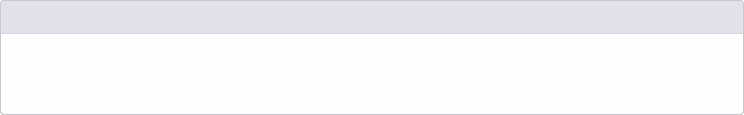
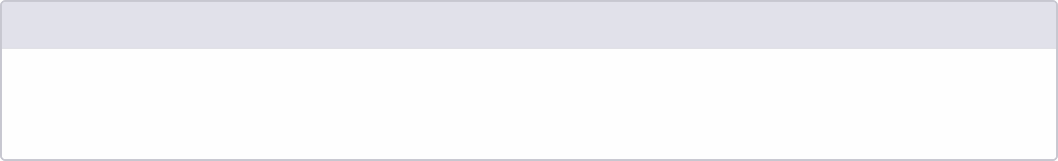
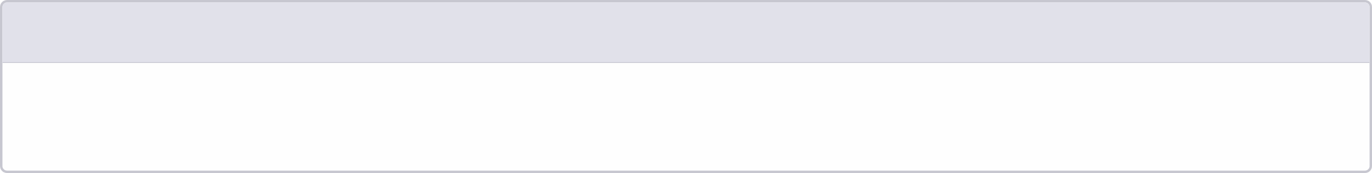
Revenue Model
1
PRIMARY REVENUE
Transaction commission on every successful deal.
Commission rate and payer: Seller / Buyer / Both — to be validated.
2
FUTURE REVENUE STREAMS
Featured Listings
Premium Company Subscriptions
3
INITIAL GOAL
Validate the transaction flow and commission model before scaling.

Slide 13
How to Convince the First Investor
REAL PROBLEM
B2B asset trading is fragmented across brokers, personal networks, and disconnected channels.
DIFFERENTIATED SOLUTION
One platform for:
Supply-driven: Listings → Search → Purchase
Demand-driven: RFQ → Seller Offers → Buyer Selection
Flexible selling: Auctions for uncertain asset prices
MARKET VALIDATION
01
02
Customer Interviews
Early Users
03
04
Listings
RFQs
05
06
Prototype Testing
Pilot Transactions

Slide 14
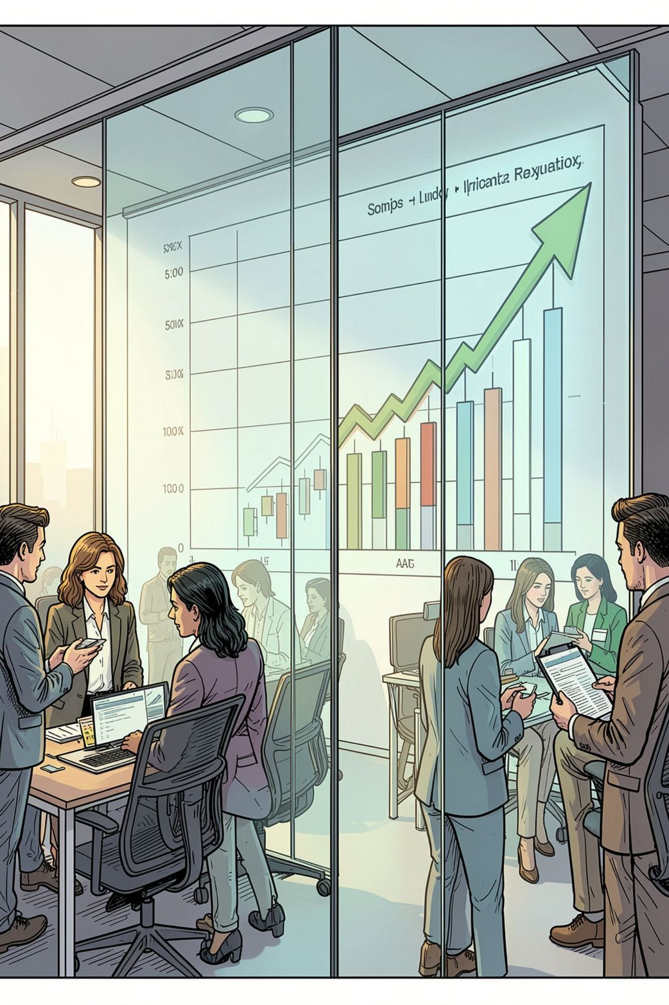







Scalable Business
USE OF FUNDING
MVP
Team
Customer Acquisition
Infrastructure
Operations
Commission-based revenue + expansion into additional asset categories
"Validate first. Scale second."

Slide 15

Thank You
Questions?
Let's connect corporate assets with opportunity.

